Slide 1

Today’s Our Topic Is PHYSICAL QUANTITIES
BATCH => 1704A
PARTICIPants => muzammil and aqsa
Faculty => ms.wajiha

Slide 2
“DEFINITION OF PHSICAL QUATITY”
A physical quantity is a quantity in physics that can be measured. Or a physical quantity is a physical property that can be quantified. Examples of physical quantities are mass, amount of substance, length, time, temperature, electric current.

Slide 3
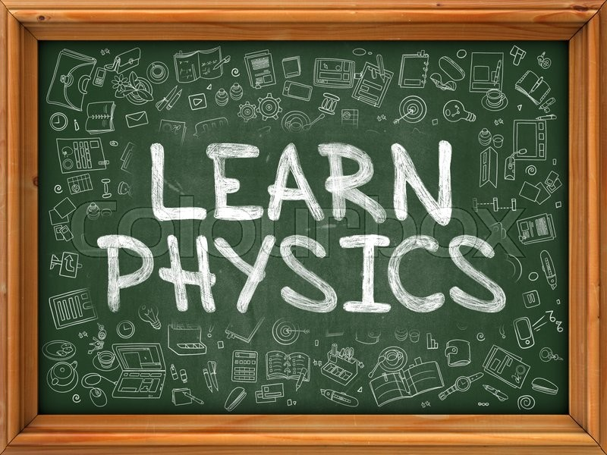
PHYSICAL QUANTIES
FUNDAMENTAL QUANTIES | SI unit | SYMBOL
LENGTH | Metre | m
MASS | Kilogram | Kg
TIME | Second | Sec
LUMINOUS INTENSITY | candela | cd
ELECTRIC CURRENT | Ampere | A
TEMERETURE | Kelvin | K
AMOUNT OF SUBSTANCE | mole | mol

Slide 4


WHAT IS MASS
In physics, mass is a property of a physical body. It is the measure of an object's resistance to acceleration (a change in its state of motion) when a net force is applied. It also determines the strength of its mutual gravitational attraction to other bodies. The basic SI unit of mass is the kilogram (kg).

Slide 5
DIFFRENCE BETWEEN MASS AND WEIGHT
MASS | WEIGHT
The quantity of matter contained In a body | weight is the force with which earth attracts o body towards its centre
Mass is scaler quantity | weight is vector quantity `
SI unit of mass is kilogram(Kg) | SI unit of weight is newton(N)
Mass=force/acceleration | weight=mg
Mass is independent quantity | Weight is dependent quantity
DEFINATION
Physical nature
SI unit
expression
Dependent

Slide 6

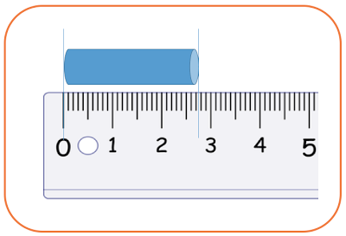
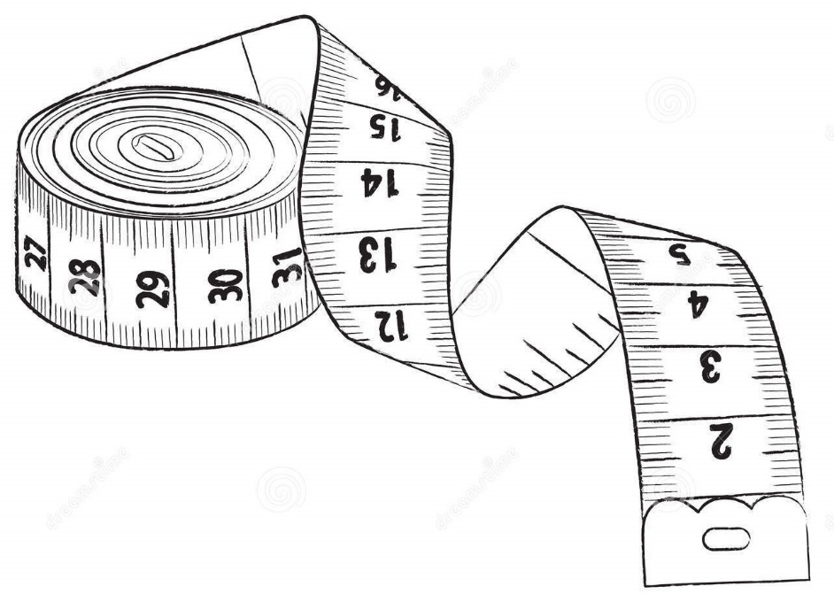
WHAT IS LENGTH
Length is defined as the straight-line distance
between two points along an object.
The SI unit of length is the meter,

Slide 7


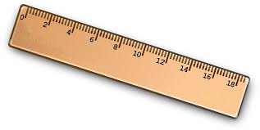
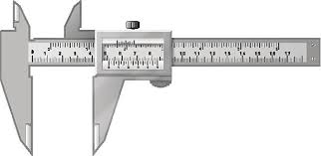
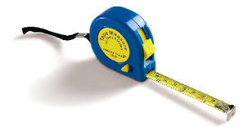
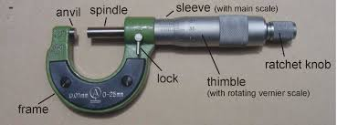
Measuring instruments of length
ruler
Trundle wheel
Vernier caliper
Screw gauge
Retractable tape

Slide 8



WHAT IS TIME
Time in physics is defined by its measurement: time is what a clock reads. In classical, non-relativistic physics it is a scalar quantity and, like length, mass, and charge, is usually described as a fundamental quantity.

Slide 9

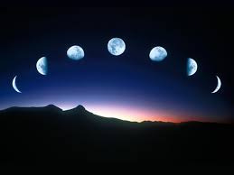
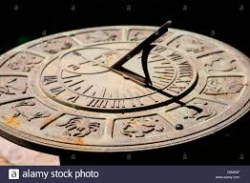
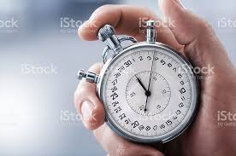


HOW TIME CAN BE MEASURE???
PHASES OF MOON
STOP WATCH
SUNDIL
SUNSETS
SEASONS

Slide 10

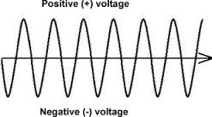
WHAT IS CURRENT
Electric current is defined as the rate at which charge flows through a surface (the cross section of a wire, for example).It’s SI unit is ampere .

Slide 11

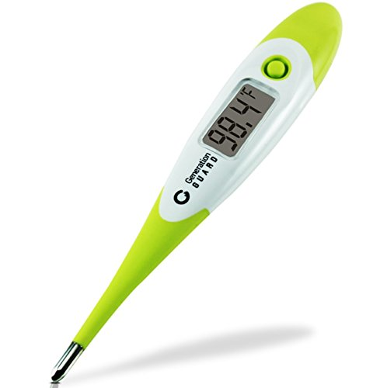
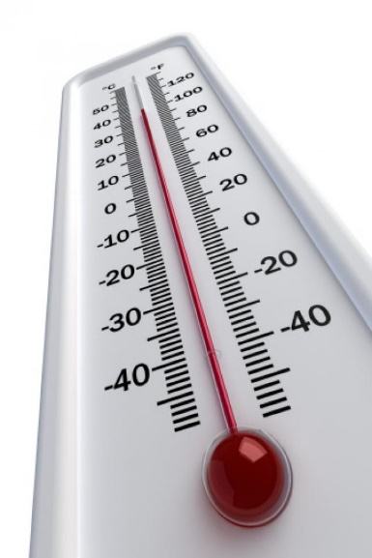
WHAT IS TEMPERATURE
The degree of hotness or coldness of a body or environment is called temperature. A measure of the average kinetic energy of the particles in a sample of matter, expressed in terms of units or degrees designated on a standard scale. It’s SI unit is KELVIN.

